Slide 1
Reinforcement Learning-Based Energy Management of Smart Home with Rooftop Solar Photovoltaic System, Energy Storage System, and Home Appliances
HaeJoong Lee
Sogang University, EE
2020.02.??

Slide 2
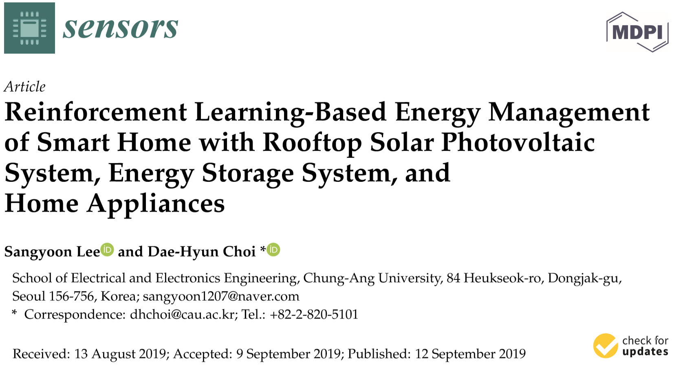
Key words
- home energy management system (HEMS)
- reinforcement learning
- artificial neural network
- smart home
- consumer comfort
- smart grid

Slide 3
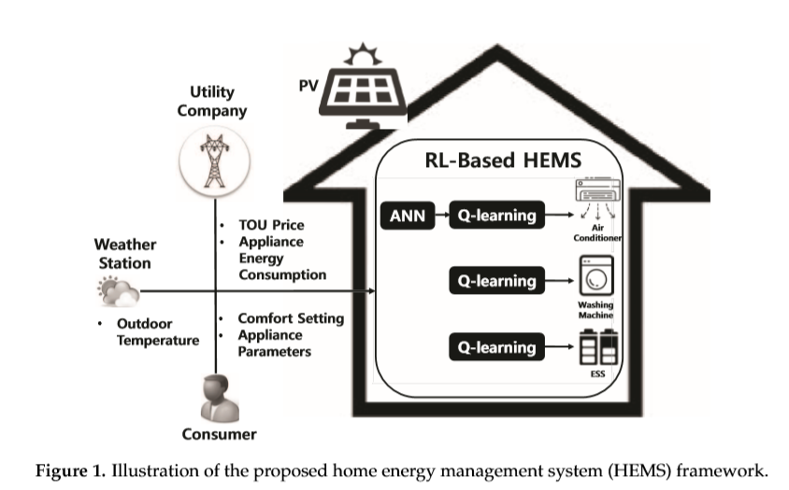
Introduction
Compared to the existing model-based HEMS optimization approaches, we propose a HEMS algorithm using a model-free reinforcement learning (RL).
the Q-learning method is applied to the energy consumption scheduling of different home appliances (air conditioner, washing machine, and ESS), whereby the agent of each appliance determines the optimal policy independently to reduce its own electric cost within the consumer comfort level and the appliance operation characteristics.
an ANN model to learn the relationship between the indoor temperature and energy consumption of the air conditioner more accurately, which is integrated into the Q-learning module to achieve improved performance of the air conditioner agent.
Simulation showed two results.
1. Using reinforcement learning and
ANN prediction techniques, power
consumption and user
dissatisfaction were reduced.
2. It can save more energy than the
existing mixed-integer linear
programming algorithm.

Slide 4
Related Research
model-based HEMS optimization
the scheduling of different types of home appliances along with electric vehicles using linear programming (LP)
load scheduling considering the consumer comfort level using mixed integer nonlinear programming (MINLP)
convex programming based on relaxed MINLP using an L1 regularization technique
load scheduling for a single consumer or multiple consumers using MILP
LP-based joint optimization of energy supplies and electric loads through three-stage scheduling (prediction, supply control, and demand control)
the natural aggregation algorithm (NAA)-based HEMS method consisting of forecasting, day-ahead scheduling, and actual operation
robust optimization for the scheduling of home appliances to resolve the uncertainty of consumer behavior the outdoor temperature and consumer comfort levels and distributed HEMS architectures consisting of a local and global HEMS.
using real-time pricing, a HEMS optimization method that considers the operational dependency of various types of home appliances and consumer life style requirements was proposed in
model-free reinforcement learning (RL)

Slide 5


System Model for HEMS
Preliminary
$A^{c}$ : A controllable appliance is an appliance of which the operation is scheduled and controlled by the HEMS.
$A_{r}^{c}$: a reducible appliances (e.g. air conditioner)
$A_{s}^{c}$: a shiftable appliances
$A_{s}^{c,NI}$: a non-interruptible load (e.g. : washing machine)
$A_{s}^{c,I}$: an interruptible load (e.g. : ESS)
$A^{uc}$ : An uncontrollable appliance cannot be scheduled and operated by the HEMS. (e.g. : TV, PC or lighting)
Therefore, $A^{uc}$ maintains the ﬁxed energy consumption scheduling.

Slide 6

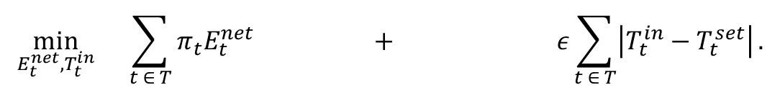






System Model for HEMS
Conventional HEMS Optimization Formulation
Object Function
$$\min_{E_{t}^{net},T_{t}^{in}}{ \sum_{t ∈ T}{π_{t}E_{t}^{net}} + ε\sum_{t ∈ T}{\left|T_{t}^{in}−T_{t}^{set}\right|}.}$$
$$J_{1}(E_{t}^{net})$$
$$J_{2}(T_{t}^{in})$$
Total electricity cost
Total penalty
(consumer discomfort cost)
$π_{t} :$ the TOU price
$T_{t}^{set}$ : the preferred consumer temperature
$E_{t}^{net} :$ net energy consumption
$T_{t}^{in}$ : the indoor temperature
$ε$ :
Penalty for consumer thermal
discomfort cost.

Slide 7
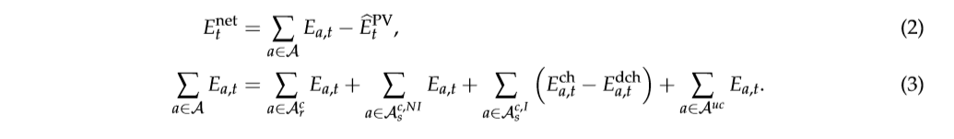







System Model for HEMS
Conventional HEMS Optimization Formulation
Constraint 1 (Net Power Consumption)
the predicted PV generation output
$A_{r}^{c}$: a reducible appliances (e.g. air conditioner)
$E_{t}^{net}$: Net energy consumption at time slot t
$A_{s}^{c}$: a shiftable appliances
$E_{a, t}^{ch}$: Charging energy of ESS a at time slot t
$A_{s}^{c,NI}$: a non-interruptible load (e.g. : washing machine)
$E_{a, t}^{dch}$: Discharging energy of ESS a at time slot t
$A_{s}^{c,I}$: an interruptible load (e.g. : ESS)
$A^{uc}$ : An uncontrollable appliance cannot be scheduled and operated by the HEMS. (e.g. : TV, PC or lighting)

Slide 8
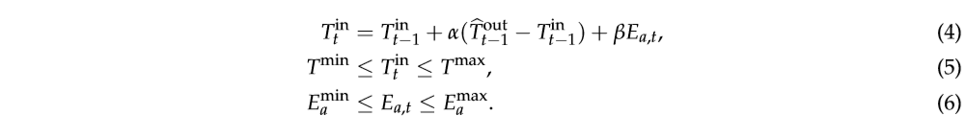





System Model for HEMS
Conventional HEMS Optimization Formulation
Constraint 2 (Operating Characteristics for Controllable Appliances)
e.g. air conditioner
$T_{t}^{in}$: in-door temperature at time t
Constraint for the temperature dynamics of the reducible appliance
$T_{t−1}^{in}$: in-door temperature at time t-1
Consumer preferred indoor temperatures range
Capacity range
${\hat{T}}_{t−1}^{out}$: the predicted outdoor temperature at time t-1
$E_{a,t}$: the energy consumption of the reducible appliances
$α , β$: the environmental parameters

Slide 9
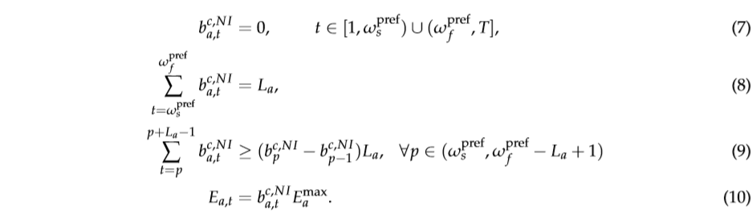


System Model for HEMS
Conventional HEMS Optimization Formulation
Constraint 3 (the desired operation of shiftable appliances with a non-interruptible load)
e.g. washing machine
$b_{a,t}^{c, NI}$: the binary decision variable , “1” for consumption, “0” otherwise
$L_{a}$: the operation period of $L_{a}$ hours during a day
$E_{a}^{max}$: Maximum consumption of appliance $a$

Slide 10
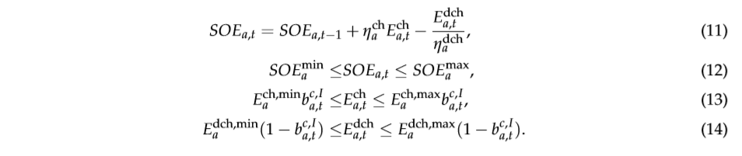


System Model for HEMS
Conventional HEMS Optimization Formulation
Constraint 4 (the operational dynamics of the state of energy (SOE) for the ESS)
e.g. ESS
$η_{a}^{ch},η_{a}^{dch}$: the charging and discharging efficiency
$E_{a,t}^{ch},E_{a,t}^{dch}$: the charging and discharging energy
${SOE}_{a}^{min },{SOE}_{a}^{max}$: the SOE capacity constraint with ${SOE}_{a}^{min}$ and ${SOE}_{a}^{max}$
$b_{a,t}^{c, I}$ : the binary decision variable that determines the ESS on/off status
“1” for charging, “0” otherwise
$E_{a}^{dch,max },E_{a}^{dch,min}$: Maximum (Minimum) discharging energy of ESS $a$

Slide 11
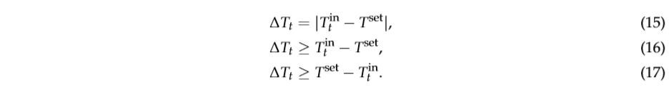
System Model for HEMS
Conventional HEMS Optimization Formulation
MINLP -> MILP by means of the linearization of the nonlinear o.f.

Slide 12
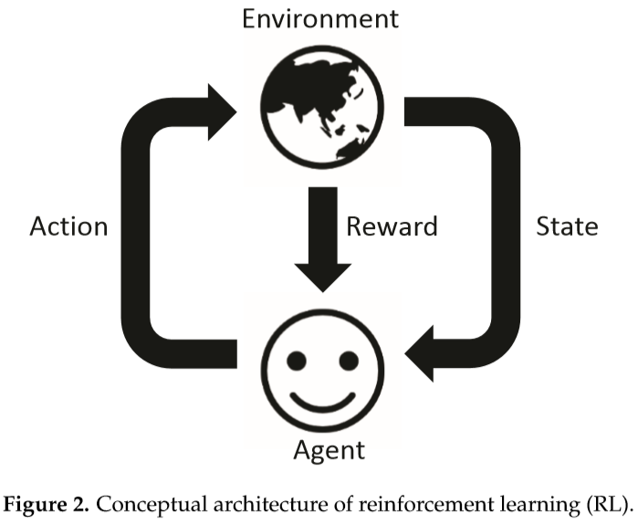

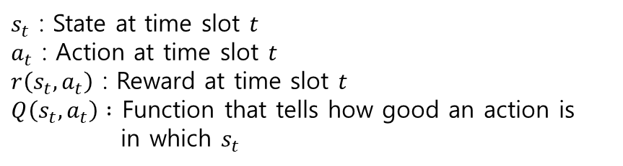


Formulation of RL- and ANN-Based Home Energy Management
Home Energy Management via Q-Learning
$s_{t}$ : State at time slot $t$
$a_{t}$ : Action at time slot $t$
$r\left(s_{t},a_{t}\right)$ : Reward at time slot $t$
$Q\left(s_{t},a_{t}\right) :$ Function that tells how good an action is
in which $s_{t}$
Bellman equation
$$Q_{v^{∗}}^{∗}\left(s_{t},a_{t}\right)=r\left(s_{t},a_{t}\right)+ γ\max{Q\left(s_{t+1},a_{t+1}\right).}$$
$$γ ∈ \left[0, 1\right]$$
Actual value
Present value
Future value
discount rate
$Q\left(s_{t},a_{t}\right)$ $←\left(1−θ\right)Q\left(s_{t},a_{t}\right)+θ\left[r\left(s_{t},a_{t}\right)+ γ\max{Q\left(s_{t+1},a_{t+1}\right)}\right]$.
$$θ ∈ \left[0, 1\right]$$
update
learning rate
$v^{∗ }=arg max Q\left(s_{t},a_{t}\right)$.

Slide 13


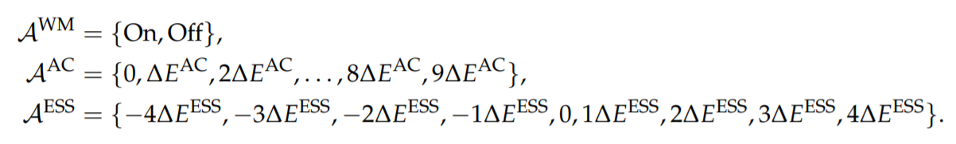


Formulation of RL- and ANN-Based Home Energy Management
Home Energy Management via Q-Learning
State Space
set
Action
Reward
Q1 : $Agent$각각 구현하는데, reward 합치는 이유?
$∆E^{AC}=40Wh$, $∆E^{ESS}=150Wh$

Slide 14
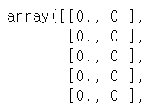




Formulation of RL- and ANN-Based Home Energy Management
Home Energy Management via Q-Learning
Given the state and action sets below
State Space
${ E}_{t}^{WM}$ : 에너지 소비량
Action
Q-value tables
Q2 : $S_{t}^{WM}$ 을 ${ E}_{t}^{WM}$ or “time(0 ~ 23)” 로 출력?
WM matrices : 24 x 2
Q-Table
$S_{t+1}^{WM}$ ?
AC matrices : 24 x 10
ESS matrices : 24 x 9
$$⋮$$

Slide 15
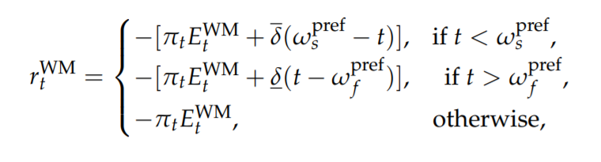


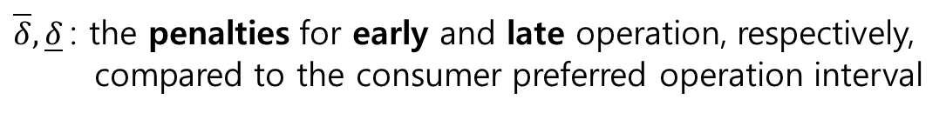
Formulation of RL- and ANN-Based Home Energy Management
Home Energy Management via Q-Learning
(i)
the reward function for the WM agent is expressed as
the electric cost and consumer undesired operation of the WM
on before $w_{s}^{pref}$
off after ${ w}_{f}^{pref}$
$w_{s}^{pref}$, $w_{f}^{pref}$ : the consumer preferred starting and finishing times of the WM
$\overline{δ}, \underline{δ}$: the penalties for early and late operation, respectively,
compared to the consumer preferred operation interval

Slide 16
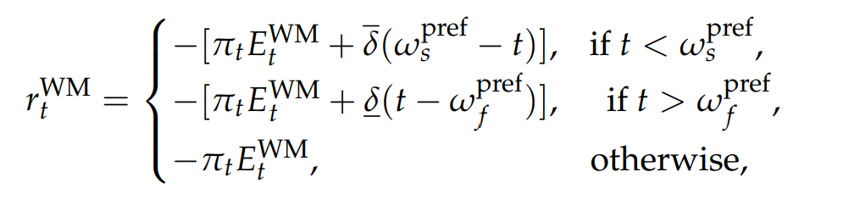
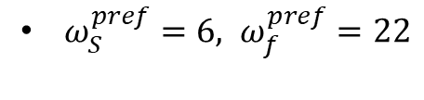

Formulation of RL- and ANN-Based Home Energy Management
Home Energy Management via Q-Learning
Washing Machine Scheduling
start
end
Case I
0
1
2
3
4
5
6
7
8
9
10
11
12
13
14
15
16
17
18
19
20
21
22
23
start
end
Case II
0
1
2
3
4
5
6
7
8
9
10
11
12
13
14
15
16
17
18
19
20
21
22
23
start
end
Case III
Q3 : $t=22 인$ 경우의 reward ?
0
1
2
3
4
5
6
7
8
9
10
11
12
13
14
15
16
17
18
19
20
21
22
23
$ω_{S}^{pref}=6, ω_{f}^{pref}=22$

Slide 17
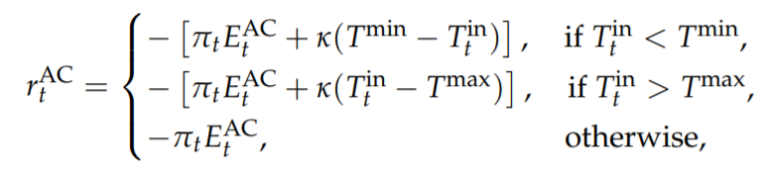

Formulation of RL- and ANN-Based Home Energy Management
Home Energy Management via Q-Learning
(ii)
the reward function for the AC agent is expressed as
the electric cost and consumer thermal discomfort of the AC
Prediction Value by ANN
$T_{t}^{in}$ : in-door temperature
$T^{min}$, $T^{max}$ : the consumer preferred temperature
$k$: the penalty for the consumer thermal discomfort

Slide 18
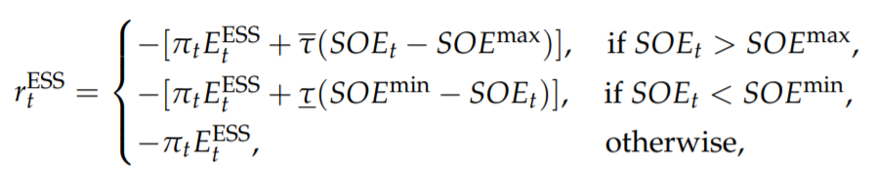

Formulation of RL- and ANN-Based Home Energy Management
Home Energy Management via Q-Learning
(iii)
the reward function for the ESS agent consists of a negative electric cost and negative energy underutilization cost
overcharging
undercharging
$${SOE}_{t} :\text{State} \text{of} \text{energy} \text{of} \text{ESS}$$
${SOE}^{max}$, ${SOE}^{min}$ : Maximum (Minimum) state of energy of ESS
$\overline{τ}, \underline{τ}$: the penalties for the ESS overcharging and undercharging

Slide 19

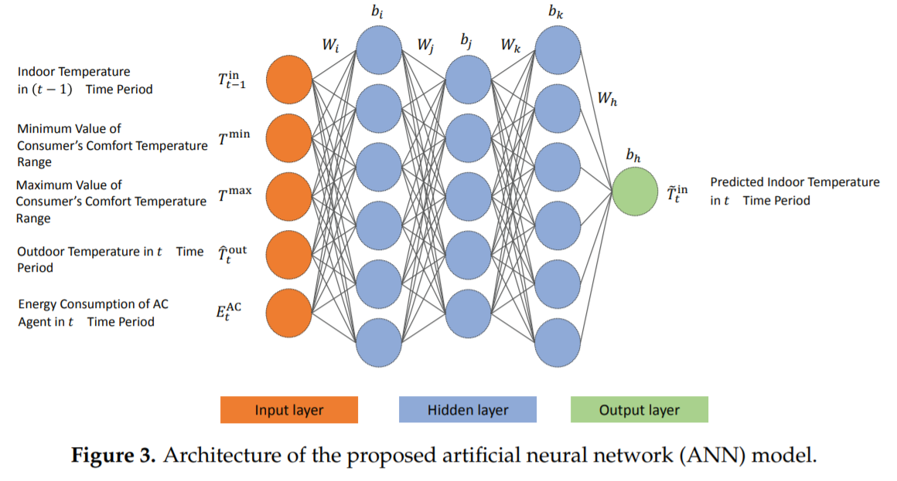
Formulation of RL- and ANN-Based Home Energy Management
Prediction of Indoor Temperature via ANN
- ANN model (Carpediem 학습 NN)
- 앞의 식 사용 (경우에 따라)
Two advantages
- calculate the dissatisfaction cost more precisely
- determine the optimal energy consumption
schedule more efficiently
Optimizer : adam
Learning rate : 0.005
Activation function : ReLU

Slide 20
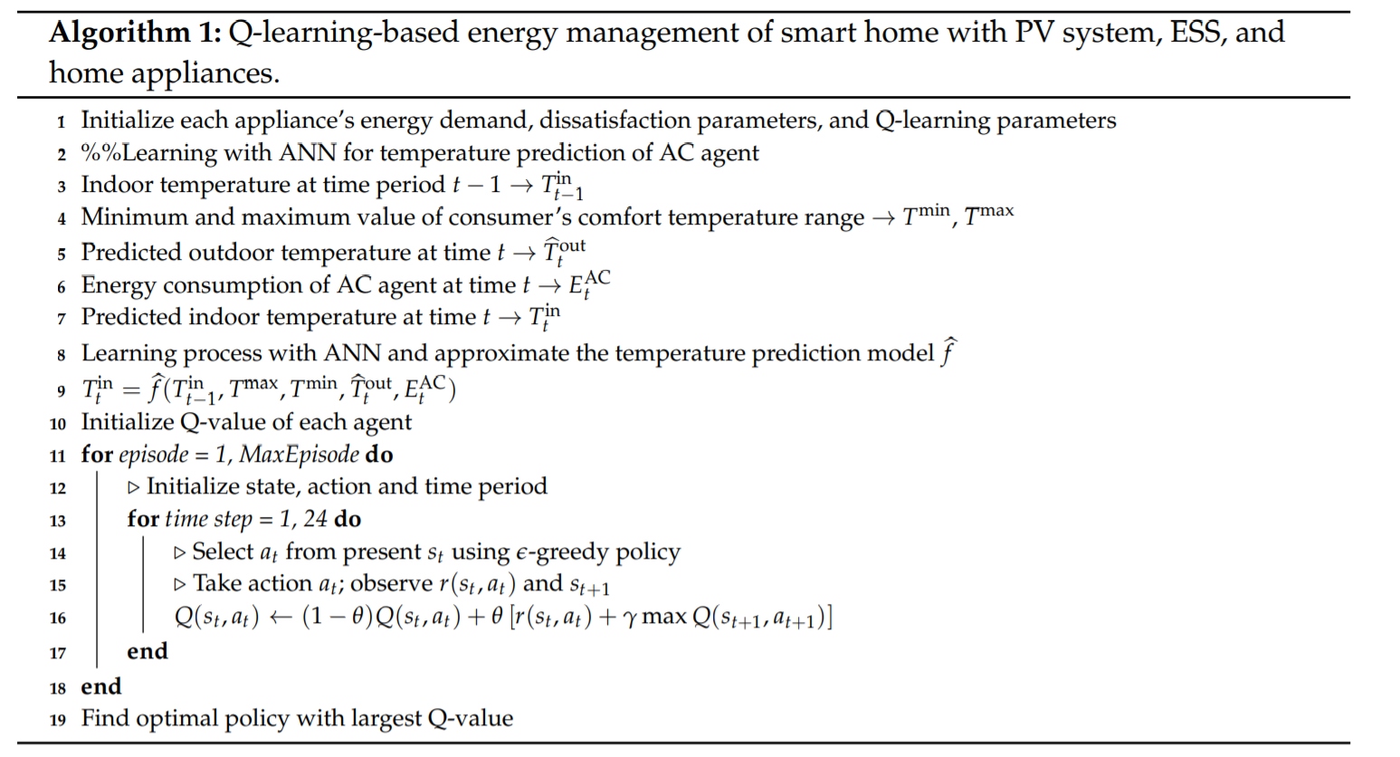
Formulation of RL- and ANN-Based Home Energy Management
Prediction of Indoor Temperature via ANN

Slide 21
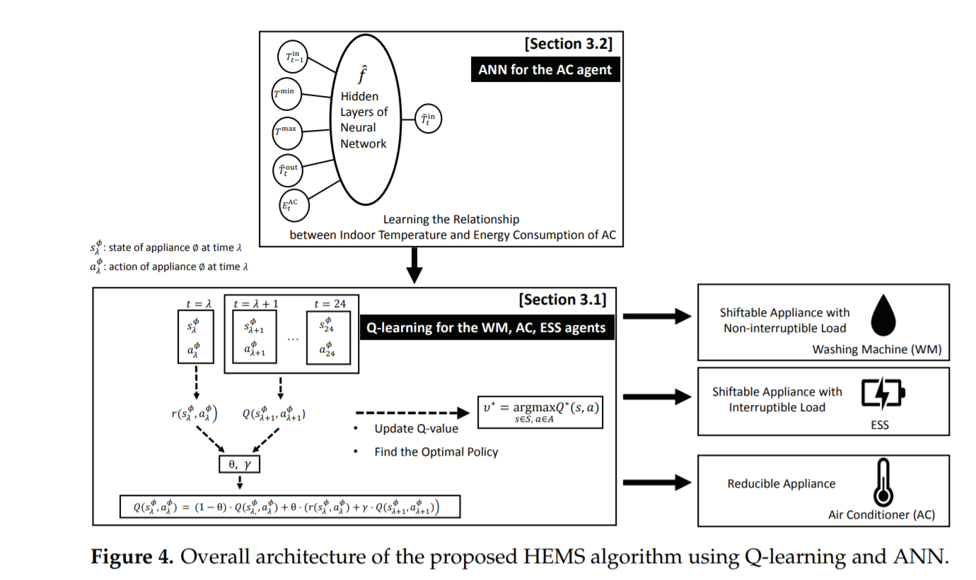
Formulation of RL- and ANN-Based Home Energy Management
Prediction of Indoor Temperature via ANN

Slide 22
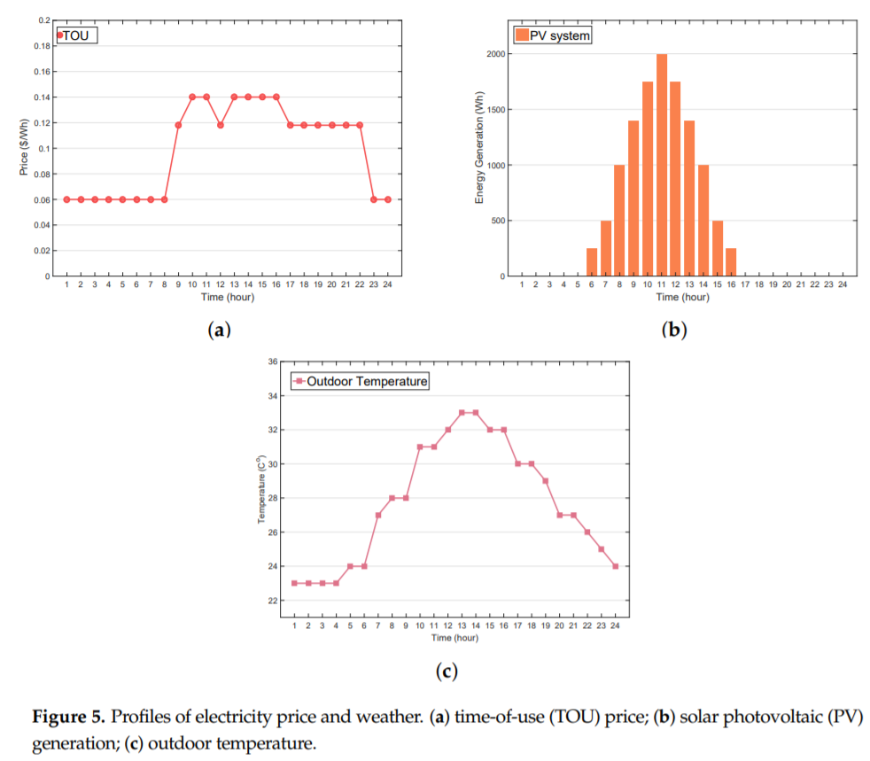
Numerical Examples
Simulation Setup

Slide 23
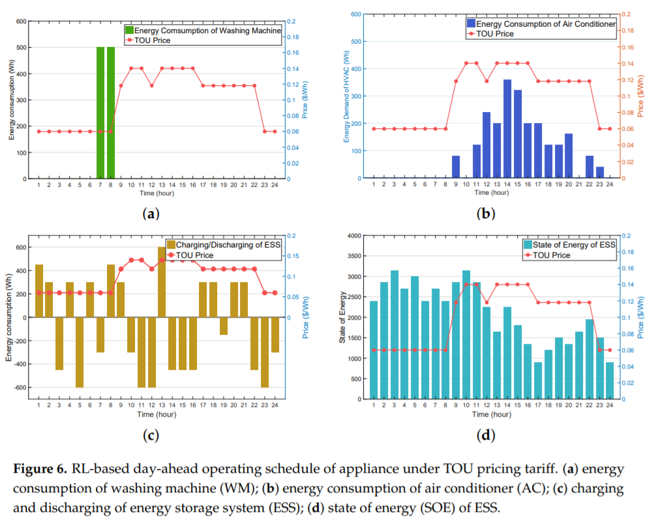
Numerical Examples
Performance of the Proposed RL-Based HEMS Algorithm

Slide 24
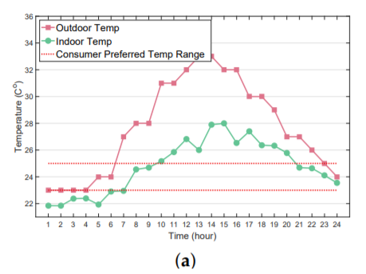
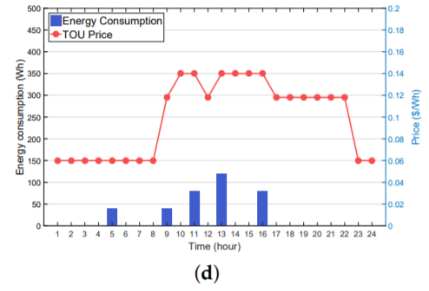
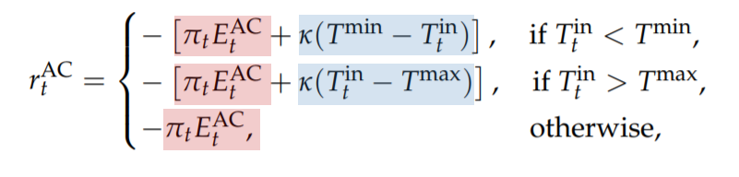
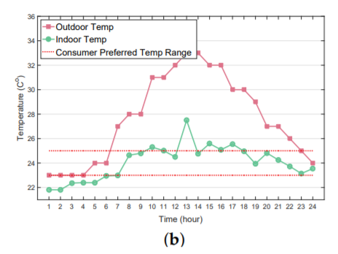
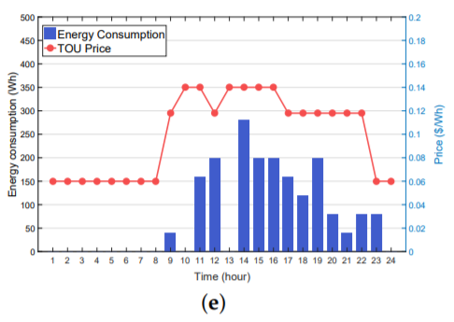
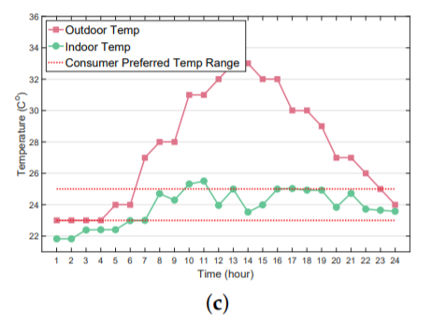
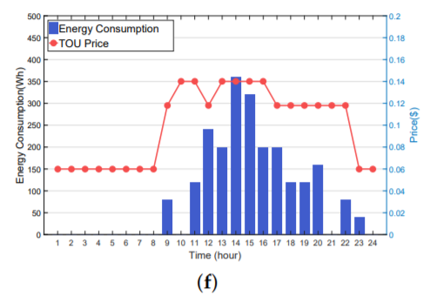






Numerical Examples
Impact of Different Parameters in Reward Function on the Proposed Algorithm
$$k=10$$
$$k=10$$
$$k=50$$
$$k=50$$
$$k=100$$
$$k=100$$

Slide 25
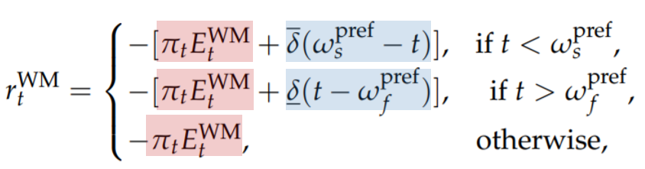
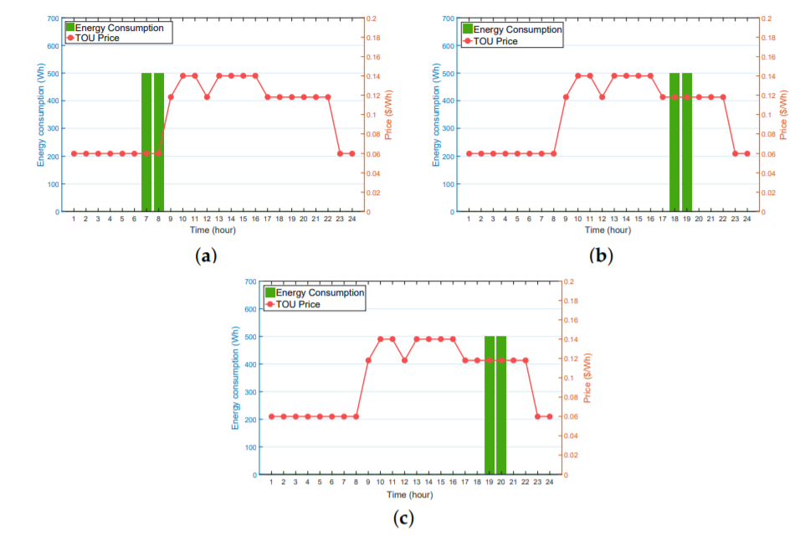
Numerical Examples
Impact of Different Parameters in Reward Function on the Proposed Algorithm

Slide 26
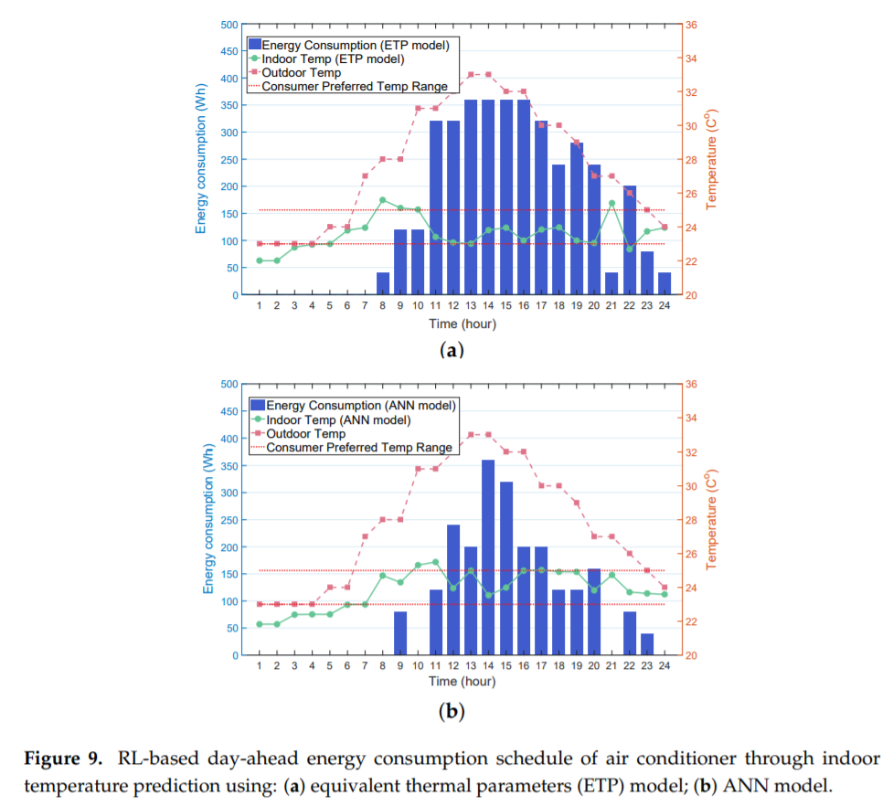
Numerical Examples
Impact of ANN on AC Agent Performance

Slide 27
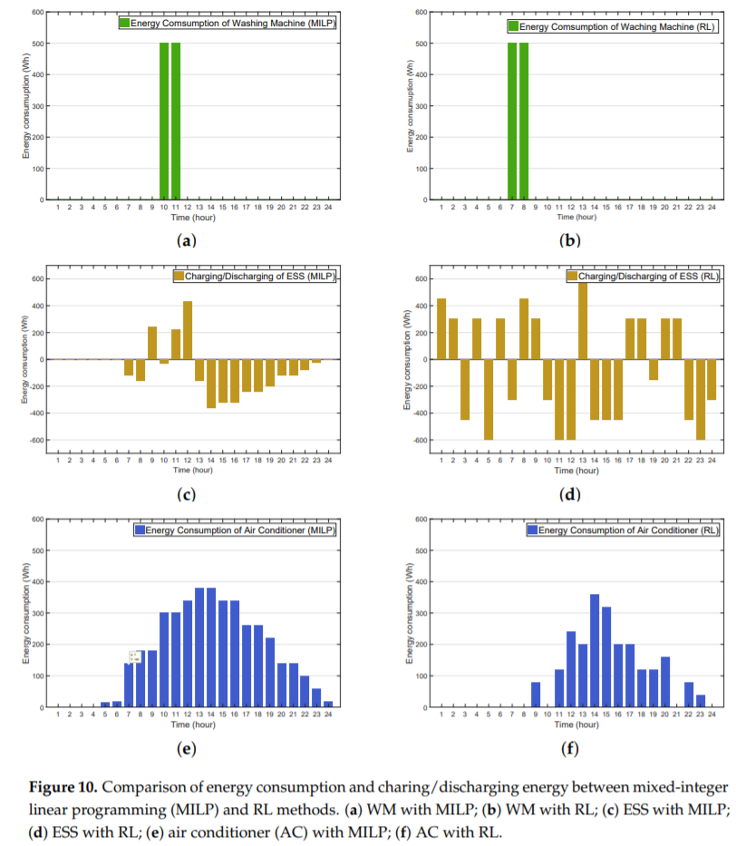
Numerical Examples
Performance Comparison between MILP- and RL-Based HEMS

Slide 28
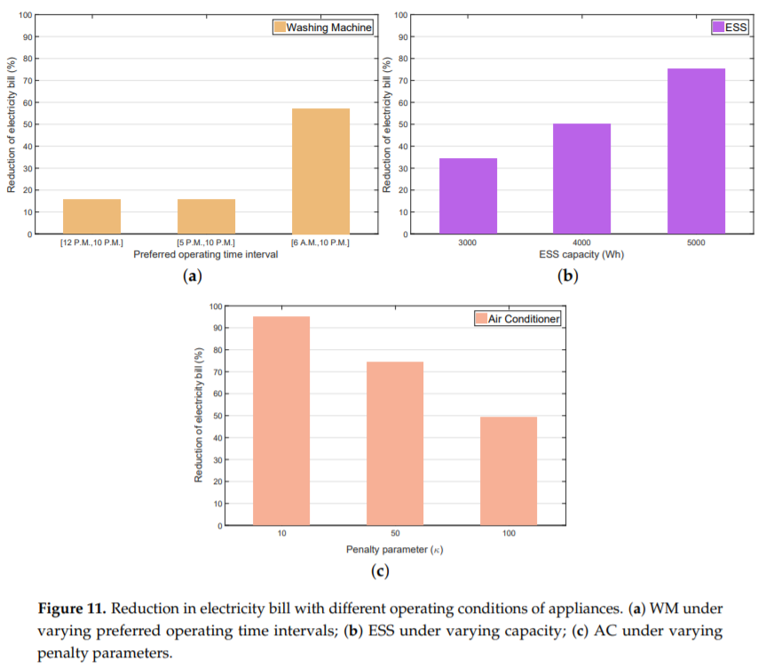

Numerical Examples
Performance Comparison between MILP- and RL-Based HEMS

Slide 29
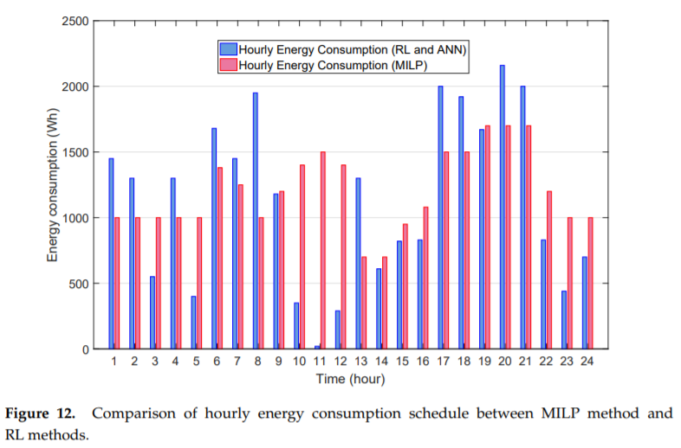
Numerical Examples
Performance Comparison between MILP- and RL-Based HEMS

Slide 30
Discussion
Wholesale and Retail Electricity Markets under Real-Time Pricing (RTP)
Electric Vehicle (EV) Integration
Constraint of the Lifetime for ESS

Slide 31
Conclusions / Future work
a multi-agent reinforcement learning algorithm that schedules the energy consumption of multiple smart homes with distributed energy resources and smart home appliances.
large-scale realistic electric power networks
use RNN and LSTM Model

Slide 32
Code implementation and experiment comparison
…

